Slide 1
Topic Modeling

Slide 2
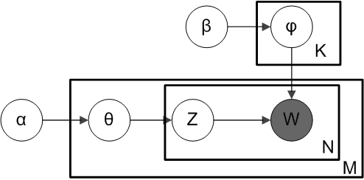
Method used
For topic modeling we decided to use Latent Dirichlet Allocation (LDA)
Used 587 tweets to form our corpus

Slide 3
Finding the number of topics used
Martin Ponweiser on Model Selection by Harmonic Mean
This finds the number of topics needed for the corpus
We have 12 topics
https://stackoverflow.com/questions/21355156/topic-models-cross-validation-with-loglikelihood-or-perplexity

Slide 4
Number of words
We are using 5 words to describe a topic
We list a tweet by the first word of the topic describing it

Slide 5
Programs used
We started using python do to built in packages
Later as the project became more complex I switched over to R
I am more familiar with R than I am with python

